Slide 1

CS 533 INTRO TO DATA SCIENCE
Michael Ekstrand

Slide 2
THE BOOTSTRAP

Slide 3

Learning Outcomes
Approximate a sampling distribution using the bootstrap
Compute a bootstrapped confidence interval for a statistic
Photo by Ashim D’Silva on Unsplash

Slide 4




Sampling the Population
Penguins
(Population)
Flipper length $μ_{fl}$
Sample of Penguins
Statistic
$$\overline{x}=\frac{1}{n}∑x_{i}$$
Sampling
Distribution
Repeat

Slide 5
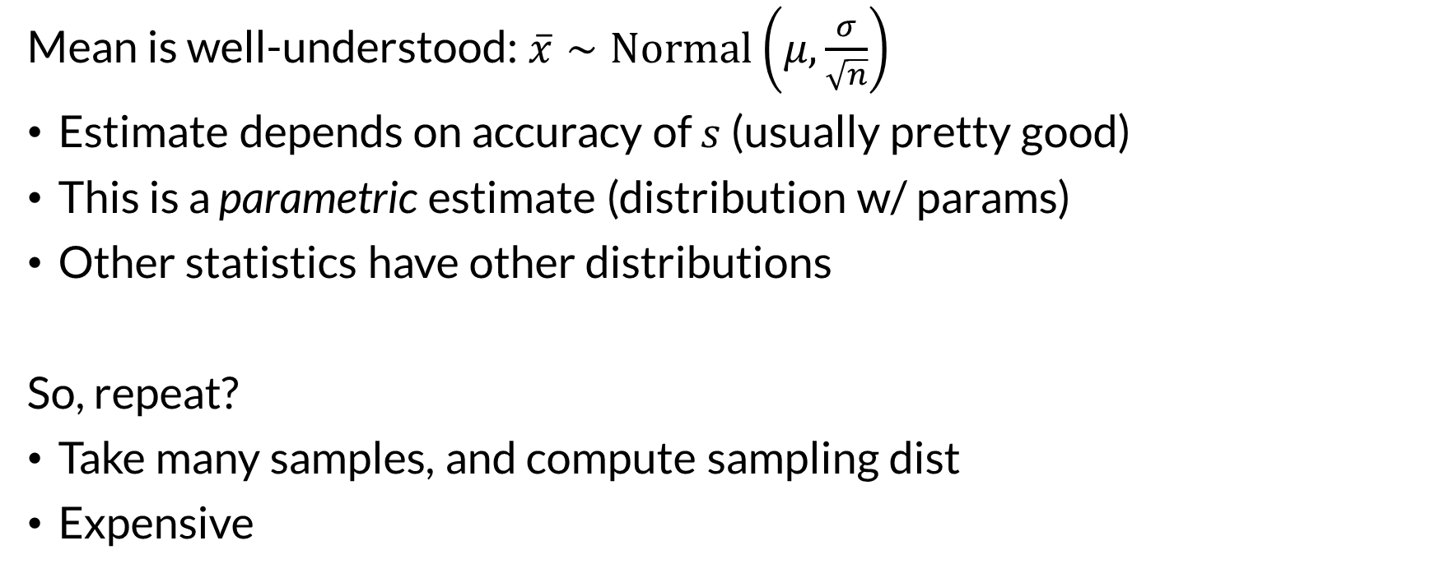
Going Beyond
Mean is well-understood: $\overline{x}∼Normal\left(μ,\frac{σ}{\sqrt{n}}\right)$
Estimate depends on accuracy of $s$ (usually pretty good)
This is a parametric estimate (distribution w/ params)
Other statistics have other distributions
So, repeat?
Take many samples, and compute sampling dist
Expensive

Slide 6
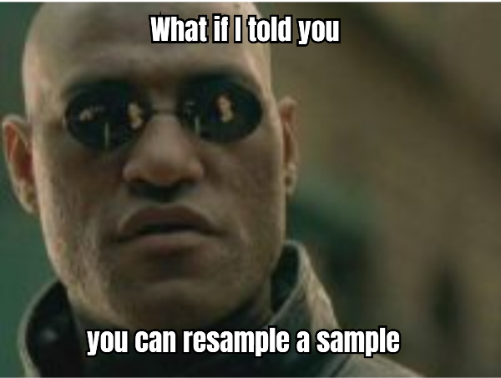

Slide 7
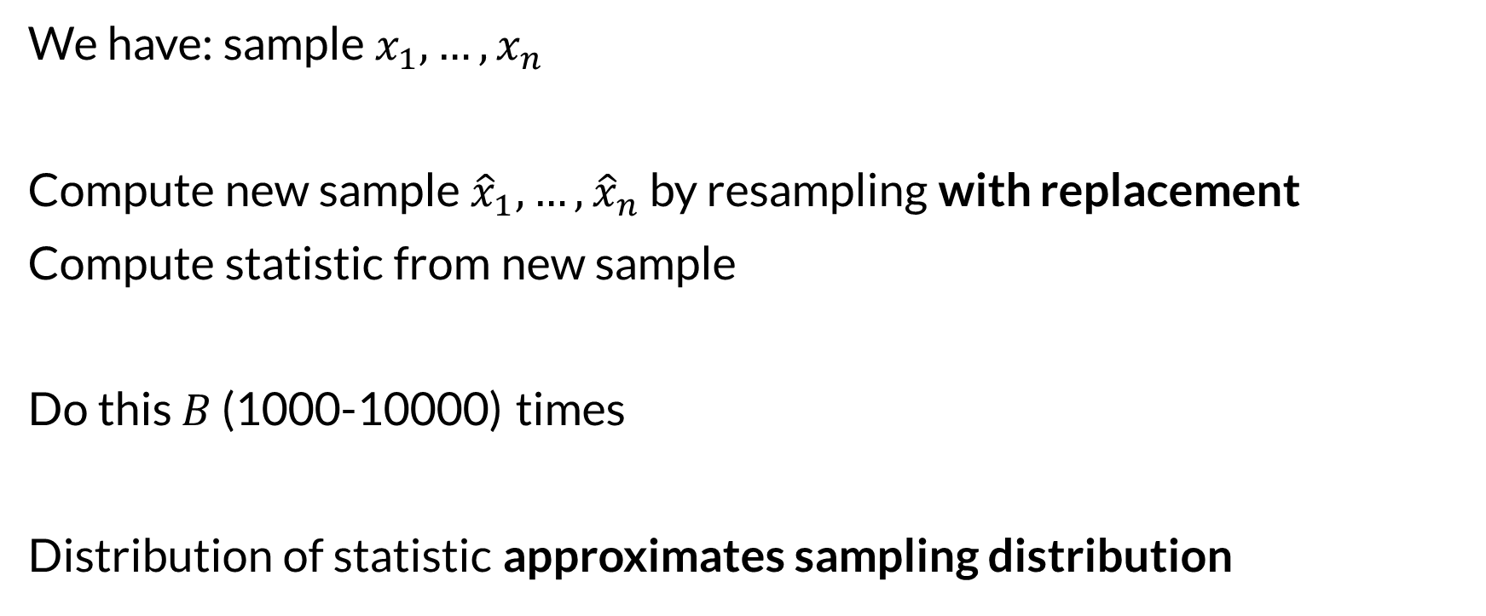
The Bootstrap
We have: sample $x_{1},…,x_{n}$
Compute new sample ${\hat{x}}_{1},…,{\hat{x}}_{n}$ by resampling with replacement
Compute statistic from new sample
Do this $B$ (1000-10000) times
Distribution of statistic approximates sampling distribution

Slide 8
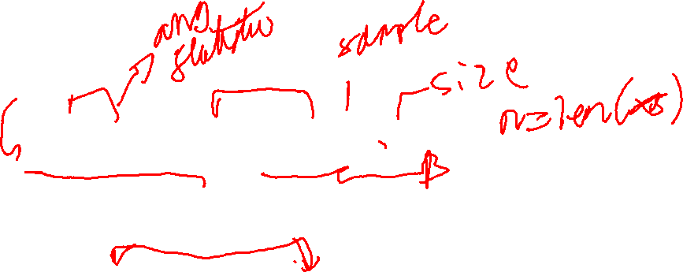
Bootstrapping a CI
Compute bootstrap means
boot_means = [np.mean(rng.choice(xs, n)) for i in range(10000)] np.quantile(boot_means, [0.025, 0.975])
Result: array([194.10294118, 197.52941176])
This is what Seaborn catplot does for error bars!

Slide 9
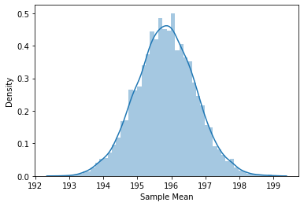
Bootstrap Distribution

Slide 10
Fun and Games with the Bootstrap
Estimate the sampling distribution for any statistic
Estimate arbitrary properties of the sampling distribution
Mean?
Median?
Quantiles?
Variance?

Slide 11

Wrapping Up
The sampling distribution requires taking multiple samples from the population.
The bootstrap allows us to approximate sampling distributions by resampling a sample.
Image from Disney’s “Club Penguin”, taken from Club Penguin Wiki

